Slide 1
Linked Lists
EENG 212
ALGORITHMS
And
DATA STRUCTURES

Slide 2
Linked Lists
A linked list is a linear collection of data elements, called nodes, where the linear order is given by means of pointers.
Each node is divided into two parts:
  The first part contains the information of the element and
  The second part contains the address of the next node (link /next pointer field) in the list.

Slide 3
Introduction
Linked list
  Linear collection of self-referential class objects, called nodes
  Connected by pointer links
  Accessed via a pointer to the first node of the list
  Link pointer in the last node is set to null to mark the list’s end
Use a linked list instead of an array when
  You have an unpredictable number of data elements
  You want to insert and delete quickly.

Slide 4
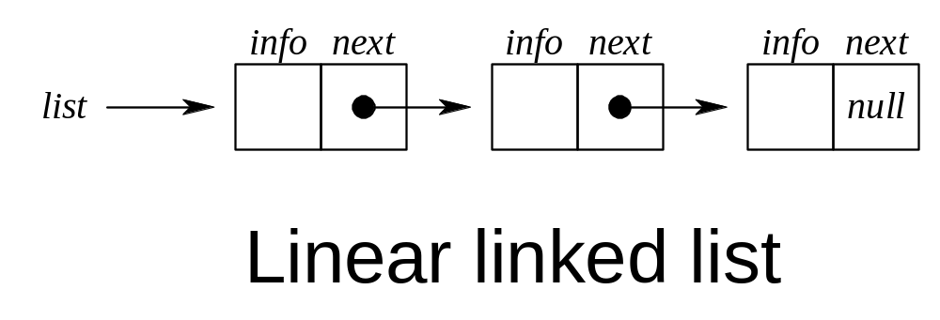
Linked Lists

Slide 5
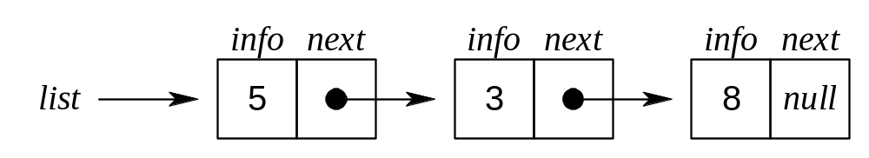
Adding an Element to the front of a Linked List

Slide 6
Some Notations for use in algorithm (Not in C programs)
p: is a pointer
node(p): the node pointed to by p
info(p): the information portion of the node
next(p): the next address portion of the node
getnode(): obtains an empty node
freenode(p): makes node(p) available for reuse even if the value of the pointer p is changed.

Slide 7
LINKED LISTS STRUCTURES AND BASIC FUNCTIONS
The value zero can be used in a C program as the null pointer. You can use the following line to declare the NULL constant. Note that a NULL pointer is considered NOT to point any storage location.
#define NULL 0
The following node structure can be used to implement Linked Lists. Note that the info field, which can be some other data type (not necessarily int), keeps the data of the node and the pointer next links the node to the next node in the Linked List.
struct node{
int info;
struct node *next;
};

Slide 8
LINKED LISTS STRUCTURES AND BASIC FUNCTIONS
When a new node is required (e.g. to be inserted into the list) the following function, getnode, can be used to make a new node to be available for the list.
node* getnode(void)
{
node *p;
p = new node;
return p;
}

Slide 9
LINKED LISTS STRUCTURES AND BASIC FUNCTIONS
When a new node is no longer used (e.g. to be deleted from the list) the following function, freenode, can be used to release the node back to the memory.
void freenode(node *p)
{
delete p;
}

Slide 10
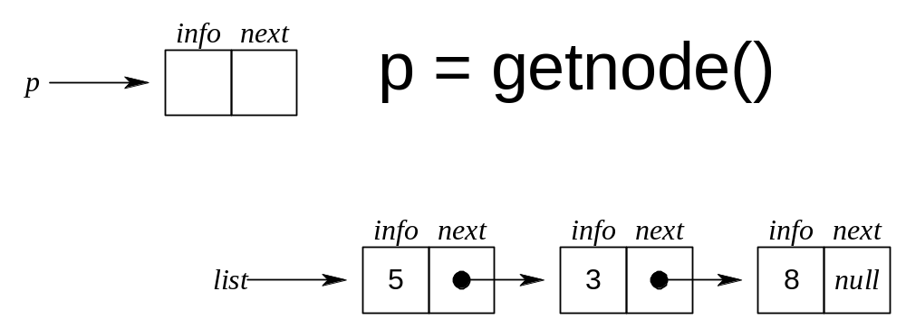
Adding an Element to the front of a Linked List

Slide 11
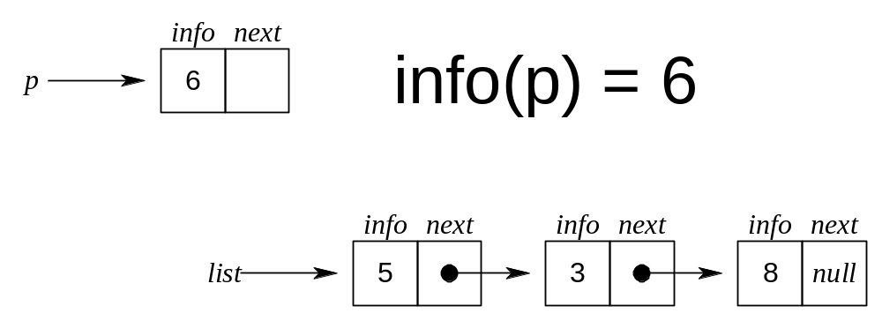
Adding an Element to the front of a Linked List

Slide 12
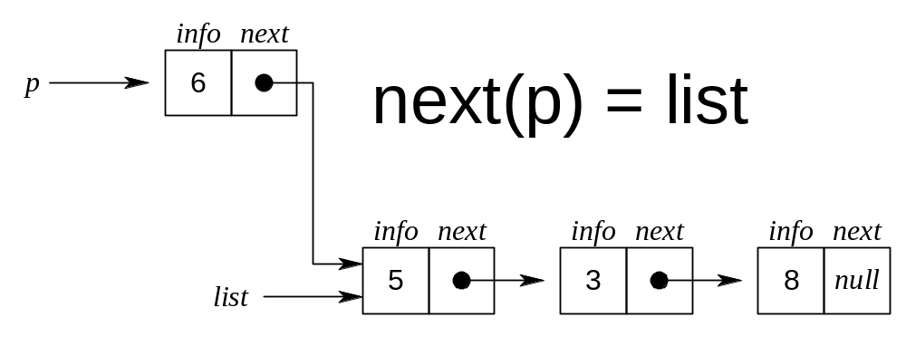
Adding an Element to the front of a Linked List

Slide 13
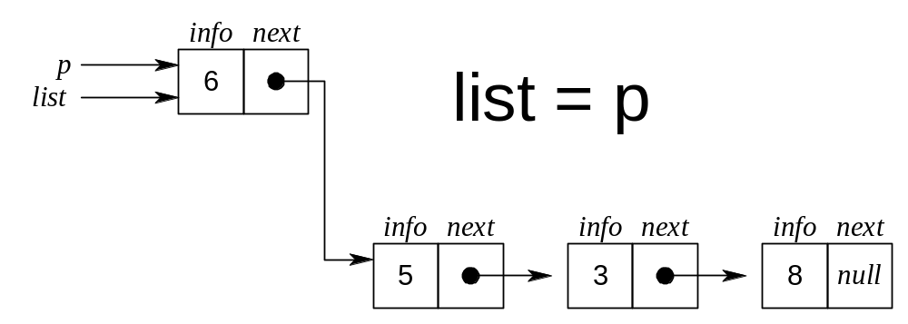
Adding an Element to the front of a Linked List

Slide 14
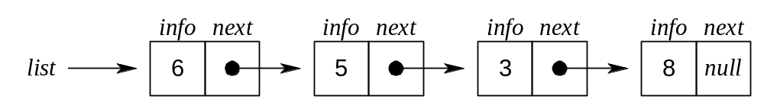
Adding an Element to the front of a Linked List

Slide 15
Removing an Element from the front of a Linked List

Slide 16
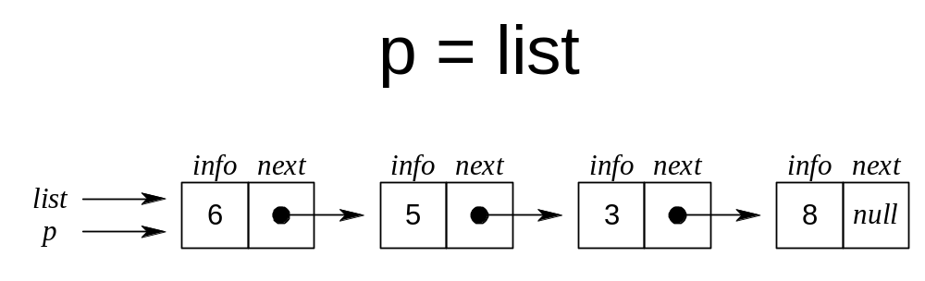
Removing an Element from the front of a Linked List

Slide 17
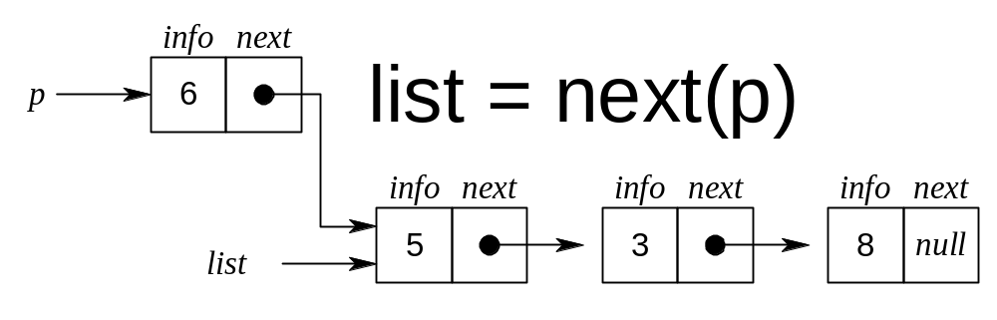
Removing an Element from the front of a Linked List

Slide 18
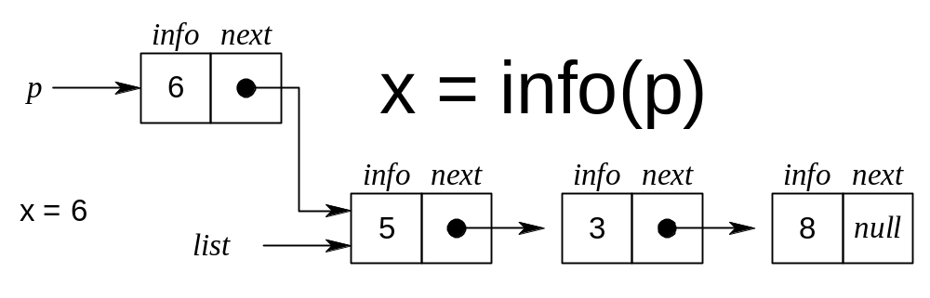
Removing an Element from the front of a Linked List

Slide 19
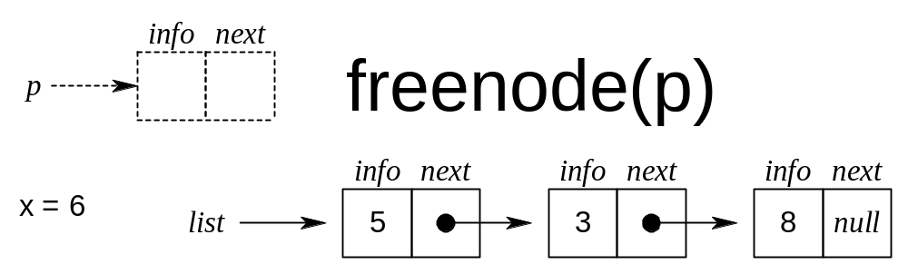
Removing an Element from the front of a Linked List

Slide 20
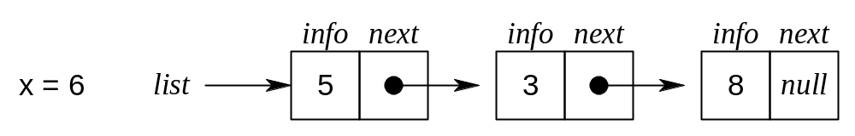
Removing an Element from the front of a Linked List

Slide 21
Linked List as a Data Structure
An item is accessed in a linked list by traversing the list from its beginning.
An array implementation allows acccess to the nth item in a group using single operation, whereas a list implementation requires n operations.
The advantage of a list over an array occurs when it is necessary to insert or delete an element in the middle of a group of other elements.

Slide 22
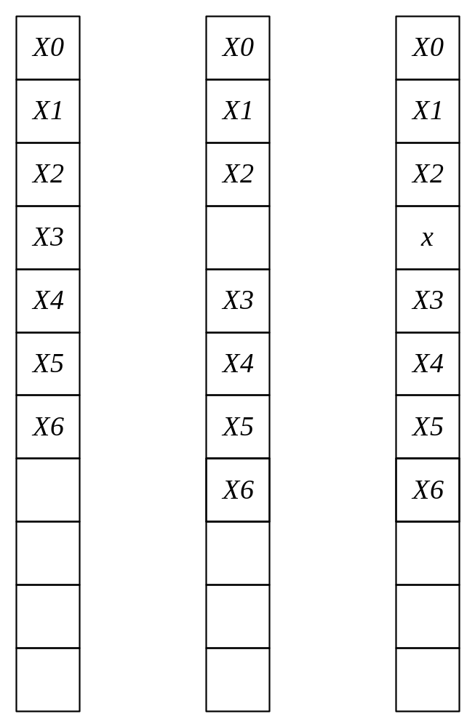
Element x is inserted between the third an fourth elements in an array

Slide 23
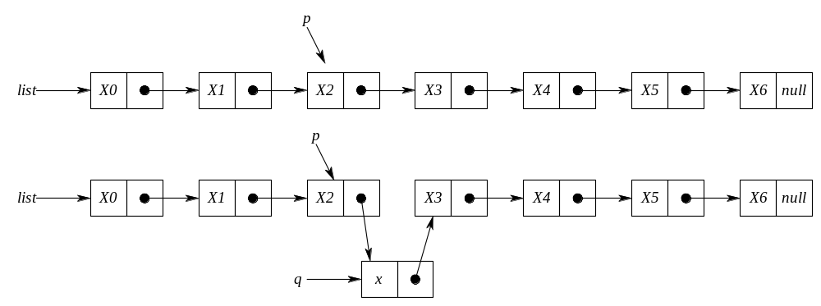
Inserting an item x into a list after a node pointed to by p

Slide 24
Inserting an item x into a list after a node pointed to by p
q=getnode();
info(q)=x;
next(q)=next(p);
next(p)=q;

Slide 25
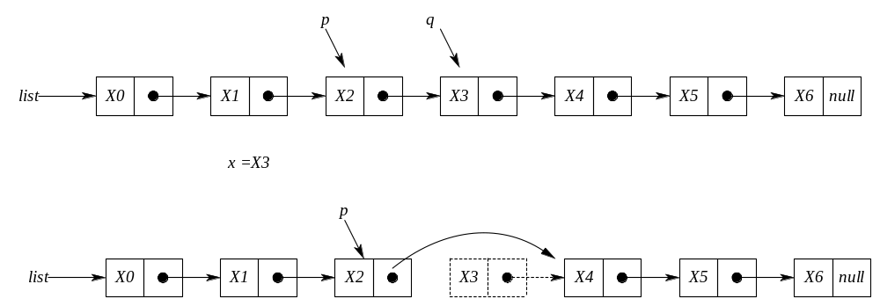
Deleting an item x from a list after a node pointed to by p

Slide 26
Deleting an item x from a list after a node pointed to by p
q=next(p);
x=info(q);
next(p)=next(q);
freenode(q);

Slide 27
PRIMITIVE FUNCTIONS FOR LINEAR LINKED LISTS
The following functions insertafter(p,x) and delafter(p,px) are primitive functions that can be used for the dynamic implementation of a linked list. Assume that list is a pointer variable pointing the first node of a list (if any) and equals NULL in the case of an empty list.

Slide 28
void insertafter(node *p, int x)
{
node *q;
if(p == NULL){
cout<<"void insertion";
exit(1);
}
q=getnode();
q->info = x;
q->next = p->next;
p->next = q;
}

Slide 29
void delafter(node *p , int *px)
{
node *q;
if((p == NULL) || (p->next == NULL)){
cout<<“void deletion";
exit(1);
}
q = p->next;
*px = q->info;
p->next = q->next;
delete q;
}

Slide 30
Searching through the linked list.
The following function searches through the linked list and returns a pointer the first occurrence of the search key or returns NULL pointer if the search key is not in the list. Note that the linked list contains integer data items.

Slide 31
Node * searchList(node *plist, int key)
{
  node *p;
  p = plist;
  while(p != NULL){
    if(p->info == key)
      return p;
    p = p->next;
  }
  return NULL;
}

Slide 32
Linked List Manipulation Algorithms
List Traversal
  Let START be a pointer to a linked list in memory. Write an algorithm to print the contents of each node of the list
  Algorithm
    set PTR = START
    repeat step 3 and 4 while PTR ≠ NULL
    print PTR->DATA
    set PTR = PTR -> LINK
    stop
10
20
30
40
1000
2000
3000
4000
10
20
30
40
50
START
Data
Link
PTR = LINK[PTR]
PTR

Slide 33
Search for an Item
Search for an ITEM
  Let START be a pointer to a linked list in memory. Write an algorithm that finds the location LOC of the node where ITEM first appears in the list, or sets LOC=NULL if search is unsuccessful.
  Algorithm
    set PTR = START
    repeat step 3 while PTR ≠ NULL
    if ITEM == PTR -> DATA, then
    set LOC = PTR, and Exit
    else
    set PTR = PTR -> LINK
    set LOC = NULL /*search unsuccessful */
    Stop
1000
2000
3000
4000
START
PTR
PTR = LINK[PTR]

Slide 34
Insert an Item
Insertion into a Listed List
  Let START be a pointer to a linked list in memory with successive nodes A and B. Write an algorithm to insert node N between nodes A and B.
  Algorithm
    Set PTR = START
    Repeat step 3 while PTR ≠ NULL
    If PTR == A, then
    Set N->LINK = PTR -> LINK (or = B)
    Set PTR->LINK = N
    exit
    else
    Set PTR=PTR->LINK
    If PTR == NULL insertion unsuccessful
    Stop
START
Node A
Node B
1000
2000
3000
4000
5000
START
Node A
Node B
1000
2000
3000
4000
5000
3500
PTR
Node N
3 cases: first node, last node, in-between node. (ex: if ITEM = 500? if ITEM = 6000?)

Slide 35
Delete an Item
Deletion from a Linked List
  Let START be a pointer to a linked list in memory that contains integer data. Write an algorithm to delete node which contains ITEM.
  Algorithm
    Set PTR=START and TEMP = START
    Repeat step 3 while PTR ≠ NULL
    If PTR->DATA == ITEM, then
    Set TEMP->LINK = PTR -> LINK, exit
    else
    TEMP = PTR
    PTR = PTR -> LINK
    Stop
  3 cases: first node, last node, in-between node. (ex: if ITEM = 1000? if ITEM = 5000?)
START
Node A
Node N
Node B
1000
2000
3000
3500
4000
5000
START
Node A
Node N
Node B
1000
2000
3000
3500
4000
5000
…..
3500
ITEM
TEMP
PTR

Slide 36
Displaying the linked list elements
Write a function to display the student with highest CGPA in a linked list containing student data. Use the following node structure for your linked list.
  struct node{
    int stNo;
    float CGPA;
    struct node *next;
  };

Slide 37
void DisplayMax(node *plist)
{
node *p;
float maxCGPA=-1.0;
int maxstNo;
p = plist; /*current node*/
if(p == NULL){
  printf(“no node/data is available in the list\n”);
  return;
}
do{
  if(p->CGPA > maxCGPA)
  {
    maxCGPA = p->CGPA;
    maxstNo = p->stNo;
  }
  p = p->next;
} while(p!= NULL);
cout<<“The student number with max CGPA:” <<maxstNo;
cout<<“The student’s CGPA:” <<maxCGPA;
}

Slide 38
Circular Linked Lists
In linear linked lists if a list is traversed (all the elements visited) an external pointer to the list must be preserved in order to be able to reference the list again.
Circular linked lists can be used to help the traverse the same list again and again if needed. A circular list is very similar to the linear list where in the circular list the pointer of the last node points not NULL but the first node.

Slide 39

Circular Linked Lists
A Linear Linked List

Slide 40
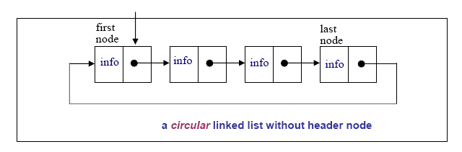
Circular Linked Lists

Slide 41
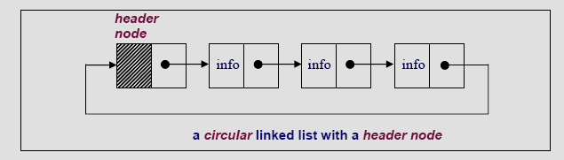
Circular Linked Lists

Slide 42
Circular Linked Lists
In a circular linked list there are two methods to know if a node is the first node or not.
  Either a external pointer, list, points the first node or
  A header node is placed as the first node of the circular list.
The header node can be separated from the others by either heaving a sentinel value as the info part or having a dedicated flag variable to specify if the node is a header node or not.

Slide 43
PRIMITIVE FUNCTIONS IN CIRCULAR LISTS
The structure definition of the circular linked lists and the linear linked list is the same:
struct node{
int info;
struct node *next;
};

Slide 44
PRIMITIVE FUNCTIONS IN CIRCULAR LISTS
The delete after and insert after functions of the linear lists and the circular lists are almost the same.
The delete after function: delafter( )
void delafter(node *p, int *px)
{
node *q;
if((p == NULL) || (p == p->next)){ /*the empty list
contains a single node and may be pointing itself*/
cout<<“void deletion”;
exit(1);
}
q = p->next;
*px = q->info; /*the data of the deleted node*/
p->next = q->next;
delete *q;
}

Slide 45
PRIMITIVE FUNCTIONS IN CIRCULAR LISTS
The insertafter function: insafter( )
void insafter(node *p, int x)
{
node *q;
if(p == NULL){
cout<<“void insertion”;
exit(1);
}
q = getnode();
q->info = x; /*the data of the inserted node*/
q->next = p->next;
p->next = q;
}

Slide 46
CIRCULAR LIST with header node
The header node in a circular list can be specified by a sentinel value or a dedicated flag:
Header Node with Sentinel: Assume that info part contains positive integers. Therefore the info part of a header node can be -1. The following circular list is an example for a sentinel used to represent the header node:
struct node{
int info;
struct node *next;
};

Slide 47
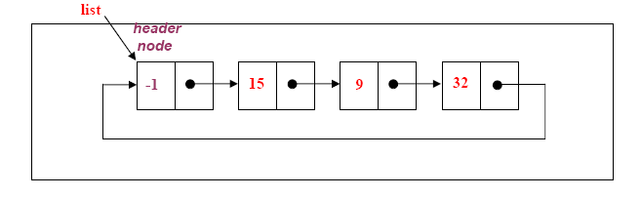
CIRCULAR LIST with header node

Slide 48
CIRCULAR LIST with header node
Header Node with Flag: In this case a extra variable called flag can be used to represent the header node. For example flag in the header node can be 1, where the flag is 0 for the other nodes.
struct node{
int flag;
int info;
struct node *next;
};

Slide 49
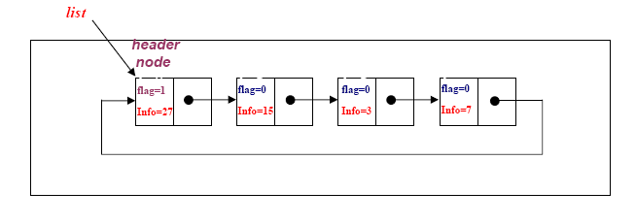
CIRCULAR LIST with header node

Slide 50
Example
Consider a circular linked list with a header node, where each node contains the name, account number and the balance of a bank customer. The header node contains a sentinel account number to be -99.
(a) Write an appropriate node structure definition for the circular linked list.
(b) Write a function to display the full records of the customers with negative balance.

Slide 51
struct node
{ char Name[15]; int AccNo;
float Balance;
struct node *next;
};
b) Assume that the list pointer points the header with the sentinel account number -99.
void DispNegBalanca(node *plist)
{
node *p;
p=*plist;
if(p == NULL){
cout<<“There is no list!”;
exit(1);
}
p=p->next;
while(p->AccNo!=-99){
if(p->Balance < 0.0)
cout<<“The Customer Name:” <<p->Name <<“The Account No:” <<p->AccNo <<“The Balance:” <<p->Balance;
p=p->next;
}
}

Slide 52
Example
Write a function that returns the average of the numbers in a circular list. Assume that the following node structure is used, where the flag variable is 1 for the header node and 0 for all the other nodes.
struct node{
int flag;
float info;
struct node *next;
};

Slide 53
float avList(node *plist) /*assume that plist points the header node*/
{
int count=0;
float sum =0.0;
node *p;
p=plist;
if((p == NULL)){
cout<<“Empty list”;
exit(1);
}
do{
sum=sum + p->info;
p =p->next;
count++;
}while(p->flag !=1);
return sum/count;
}

Slide 54
Doubly Linked Lists
In a Doubly Linked-List each item points to both its predecessor and successor
  prev points to the predecessor
  next points to the successor
10
20
40
55
70
Head
Cur->prev
Cur
Cur->next

Slide 55
Doubly Linked List Definition
struct Node{
int data;
Node* next;
Node* prev;
};

Slide 56
Doubly Linked List Operations
insertNode(NodePtr& Head, int item)
//add new node to ordered doubly linked list
deleteNode(NodePtr& Head, int item)
//remove a node from doubly linked list
SearchNode(NodePtr Head, int item)
Print(nodePtr Head, int item)

Slide 57
Deleting a Node
Delete a node Cur (not at front or rear)
(Cur->prev)->next = Cur->next;
(Cur->next)->prev = Cur->prev;
delete Cur;
10
20
40
55
70
Head
Cur

Slide 58
void deleteNode(NodePtr& head, int item) {
NodePtr cur;
cur = searchNode(head, item);
if (head==NULL) { …
}
else if (cur->prev == NULL) { …
}
else if (cur->next==NULL) { …
}
else {
(cur->prev)->next = cur->next;
(cur->next)->prev = cur->prev;
delete cur;
}
}
Empty case
At-the-beginning case
At-the-end case
General case
A systematic way is to start from all these cases, then try to simply the codes, …

Slide 59
Inserting a Node
Insert a node New before Cur (not at front or rear)
New->next = Cur;
New->prev = Cur->prev;
Cur->prev = New;
(New->prev)->next = New;
10
20
55
70
40
Head
Cur
New

Slide 60
Print the whole list:
void print(NodePtr head){
NodePtr cur=head->next;
while(cur != head){
cout << cur->data << " ";
cur = cur->next;
}
}

Slide 61
Searching a node
(returning NULL if not found the element):
NodePtr searchNode(NodePtr head, int item){
NodePtr cur = head->next;
while ((cur != head) && (item != cur->data)) cur=cur->next;
if (cur == head) cur = NULL; // we didn’t find
return cur;
}
End of the list, empty

